Slide 1









My Number Interactive Notebook
$$×$$
$$\frac{1}{2}$$
$$÷$$
$$+$$
$$−$$
$$\frac{3}{5}$$
$$7$$
Name
Class
Teacher
Term 3 Semester 2
$$5^{2}$$
$$\sqrt{9}$$
1

Slide 2
Contents
Glossary or Formula Page
Page
Date
Description
2
3

Slide 3

Tasks
24
7
30
Essential Question
Don’t forget to keep your INB up to date
Questions
Notes
You should be ticking these off!
Summary
Have YOU been doing your summaries?
Your book, your responsibility!

Slide 4
Take a guess!
How many stars do you think there are in the (observable) universe?
100 billion stars in the Milky Way and 100 billion galaxies in the universe so…
10 000 000 000 000 000 000 000
And that’s at the conservative end!!!
What about sand on every beach in the world?
Or atoms in one grain of sand?

Slide 5
As we saw yesterday, we can use Scientific notation on very large numbers.
230000 | = | 2.3 x 100000 | = | 2.3 x 10x10x10x10x10 | = | 2.3 x 10⁵
23000 | = | 2.3 x 10000 | = | 2.3 x 10x10x10x10 | = | 2.3 x 10⁴
2300 | = | 2.3 x 1000 | = | 2.3 x 10x10x10 | = | 2.3 x 10³
230 | = | 2.3 x 100 | = | 2.3 x 10x10 | = | 2.3 x 10²
23 | = | 2.3 x 10 | = | 2.3 x 10 | = | 2.3 x 10
This is know as Scientific Notation and it is a way of writing and comparing really big numbers easily.

Slide 6

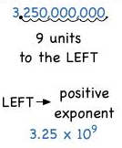
24
7
30
Scientific Notation
Date
EQ – How is scientific (index) notation used to write very large numbers?
What is scientific notation or standard form?
How do I write in scientific notation
To write in scientific notation, follow the form
where N is a number greater than 1 and but less than 10.
1. Move the decimal place to the left until it is just behind the highest number.
2. Count the number of places the decimal place was shifted – this becomes the power above the 10.
3. Write it in Scientific format.
Eg.
32 560 000
= 3.256 x 10⁷
7 6 5 4 3 2 1
11

Slide 7
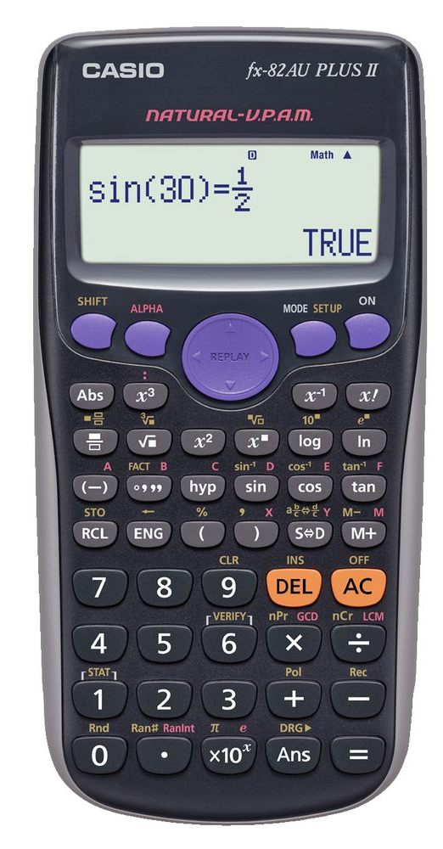
Using the calculator.
3.4 3 = 3400
x10^{x}

Slide 8





Let’s try these together

Slide 9
How many stars do you think there are in the (observable) universe?
100 billion stars in the Milky Way and 100 billion galaxies in the universe so…
10 000 000 000 000 000 000 000 = 1 x 10²²
And that’s at the conservative end!!!
What about sand on every beach in the world?
assuming an average size and using how many grains are in a teaspoon and multiplying up there is approximately 7.5 x 10¹⁸ grains of sand on the beach in the world.
Or atoms in one grain of sand?
Assuming a size of 0.00265g per grain of sand and that the sand is made from Si0₂ the there is 5 x 10¹⁹ atoms in a grain of sand.

Slide 10
Now you try
Page 148 11.10

Slide 11
Notes Review
24, 7 ,30
Date
Title
Essential question
Notes complete
Notes complete with colour and diagrams
Questions completed
Contents page filed in
Formula page filled in

Slide 12
Homework
Review your notes and write a summary answering the essential question.

